Slide 1

HCI – Assignment n.2
Universidade de Aveiro
Engenharia de Computadores e Telemática
Interação Humano-Computador
2019/2020
CookIT
Bruno Caseiro 88804 Mateusz Roganowicz 96947
Ruben Menino 89185
Teacher: Beatriz Sousa Santos Pedro Almeida
Class: P1

Slide 2

Introduction
Quarantine times are difficult
Make life easier for users
We don’t need to think about recipes
Fast and effective

Slide 3
Project Objectives
CookIT
Front-end of user friendly desktop application to store and manage recipes
Robust
Efficient
Easy to remember
No errors
Pleasant to use

Slide 4

Personas
CookIT
Joana, 40 years old
Medical School graduate
Wants to learn how to cook
Looks for an application which could facilitate cooking
Wants to have all receipts in one place
Wants to get suggestions what to cook

Slide 5

Scenario 1
CookIT
Joana wants to prepare a dish from ingredients that she currently has at home, so she picks desired ingredients and the application will propose some recipes.

Slide 6
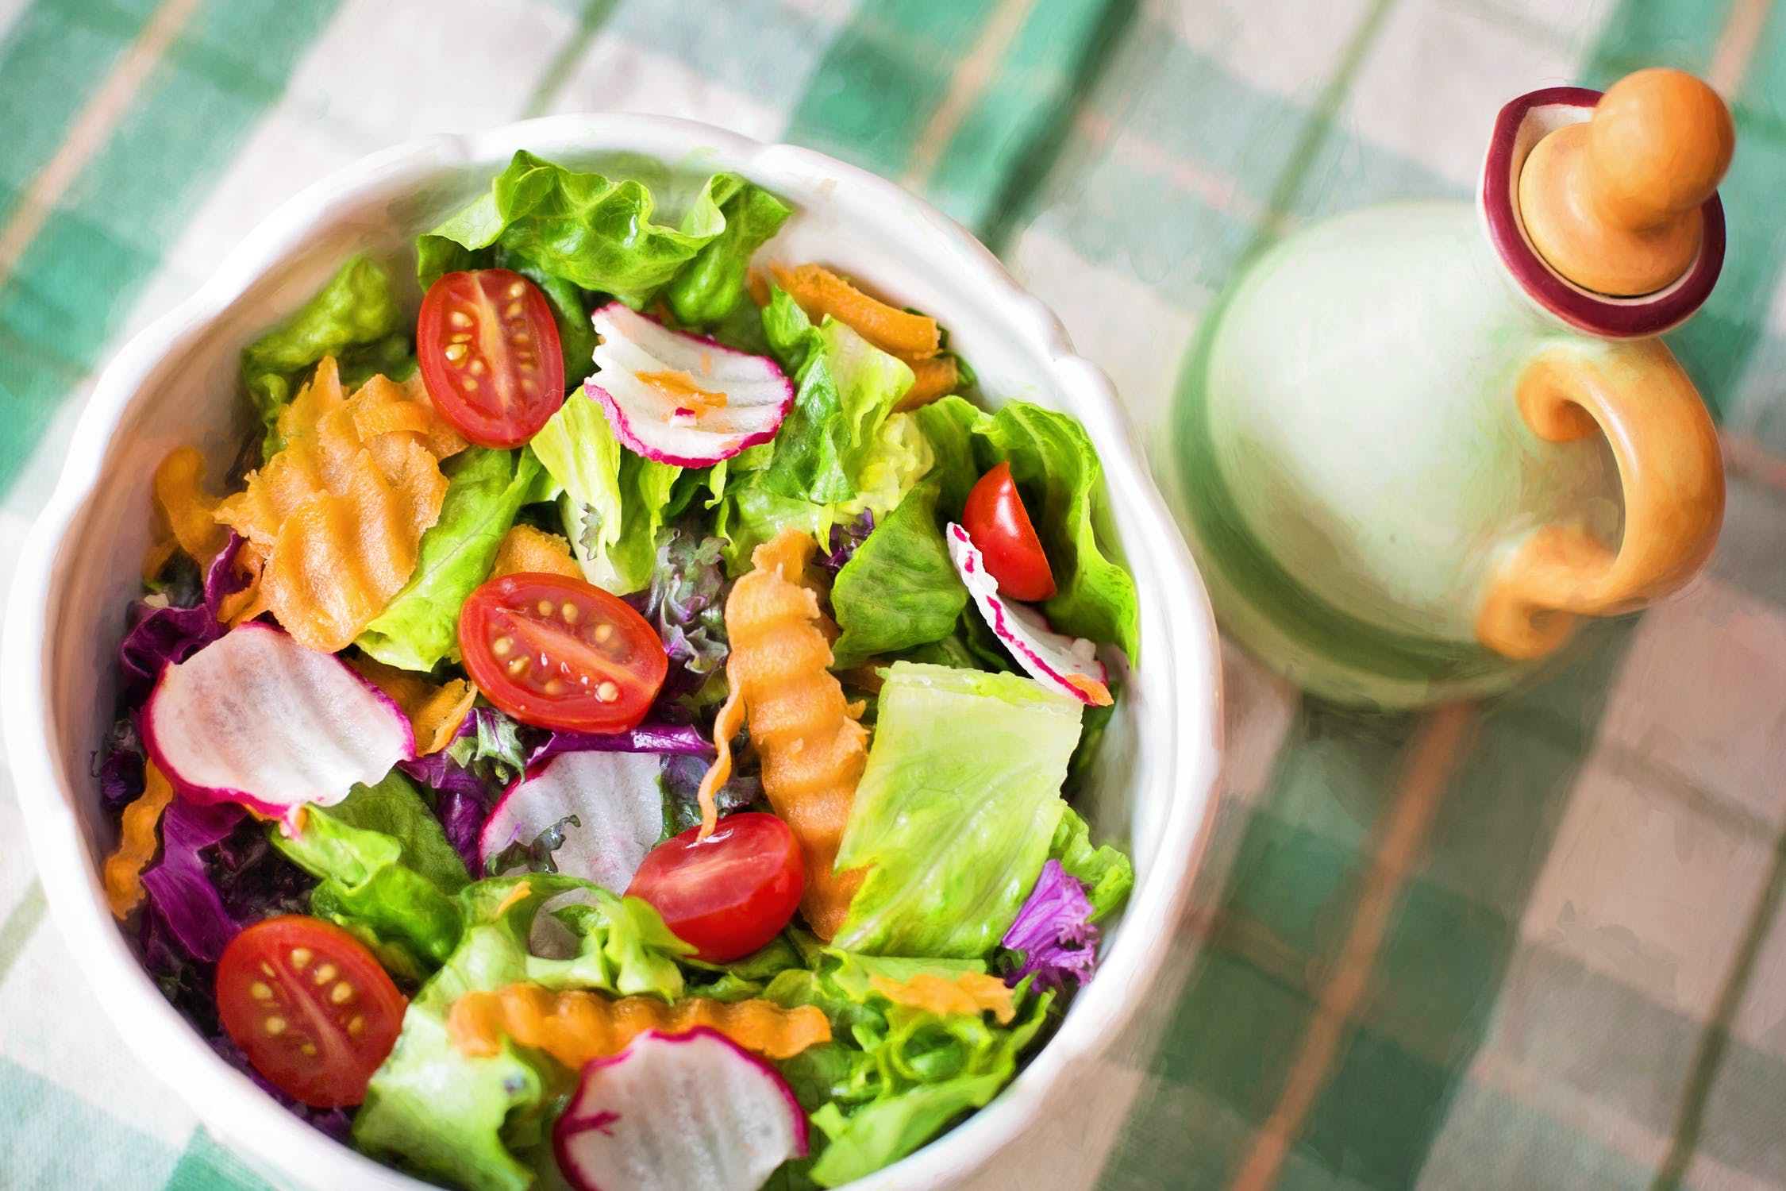
Scenario 2
CookIT
Joana wants to try a vegan dish for the first time, but isn’t sure which one. She filters the list of recipes available by category (vegan) and picks the one which seems the most appealing to her.

Slide 7
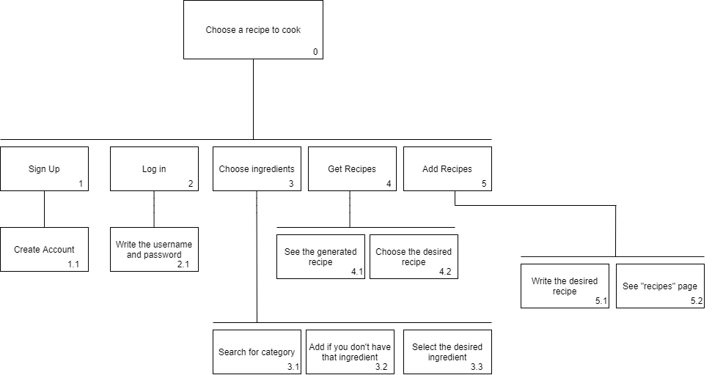
Tasks
CookIT

Slide 8
Requirements
CookIT
Non-functional requirements
Functional requirements
Usability
Implementation
Reliability
Search recipes
Add custom recipes

Slide 9

Low Fidelity Prototype
CookIT
Created using Prott

Slide 10

LFP User Evaluation
CookIT
We asked family members to perform tasks defined as scenarios
10 participants of different profile, younger siblings and parents
All of them had different cooking background, but none of them had problem with using the application

Slide 11

LFP User Evaluation
CookIT
Feedback:
Add custom recipe
Show the chosen ingredients
See all chosen ingredients

Slide 12



Platform Used for the Functional Prototype
CookIT
Windows Presentation Foundation (WPF) in Visual Studio 2019 was used to develop the application
Based on XAML and C#
Github repository to manage the project

Slide 13
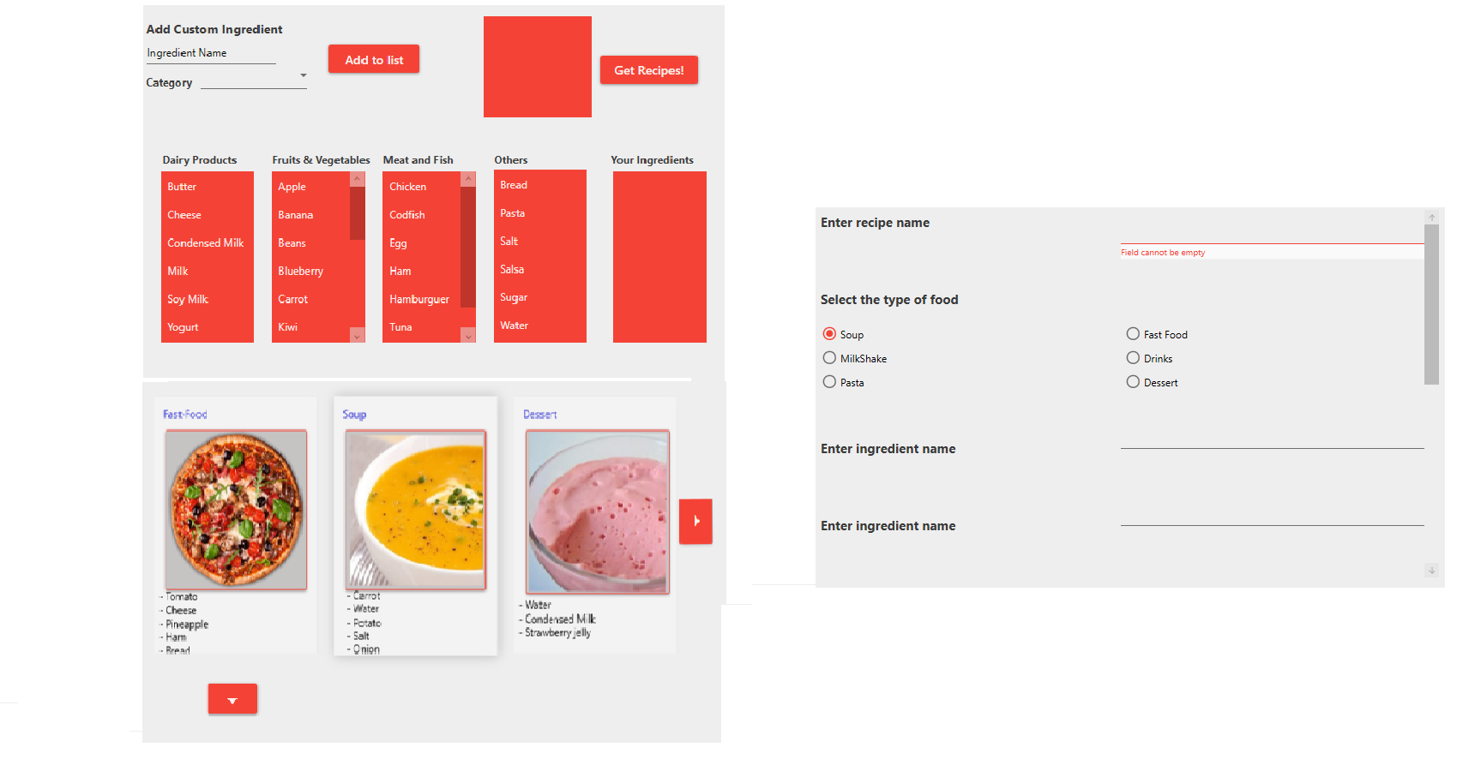
Functional Prototype
CookIT

Slide 14
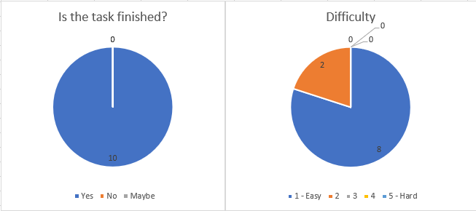
User Evaluation of the Functional Prototype
CookIT
Create an account and login, navigate to the home screen

Slide 15
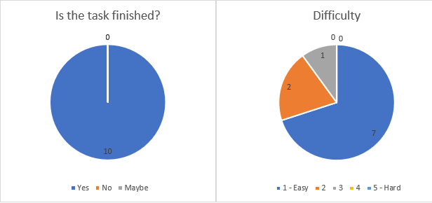
User Evaluation of the Functional Prototype
CookIT
Choose Ingredients

Slide 16
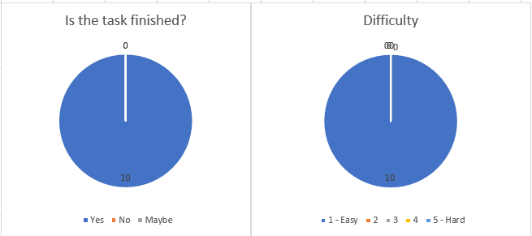
User Evaluation of the Functional Prototype
CookIT
Get Recipe

Slide 17
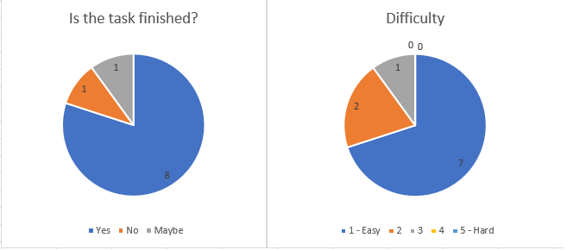
User Evaluation of the Functional Prototype
CookIT
Add Recipe

Slide 18

User Evaluation of the Functional Prototype
CookIT
Feedback:
Page “Add ingredients” with less information
More explicit categories

Slide 19

Future Work
CookIT
CookIt has some room for improvement in the future
More recipes
More ingredients
Improve, user interaction
Develop backend of the application

Slide 20
Acknowledgments
CookIT
Thank you for attention!
Bruno Caseiro 88804 Mateusz Roganowicz 96947 Ruben Menino 89185

